Slide 1
Blue Prism RPA Consolidation Exercise Solution
Jason Santucci

Slide 2

The goal
The goal of this exercise is to program Blue Prism to read customer data from an Excel Sheet and input the data into a software named Data Centrix Solutions.

Slide 3
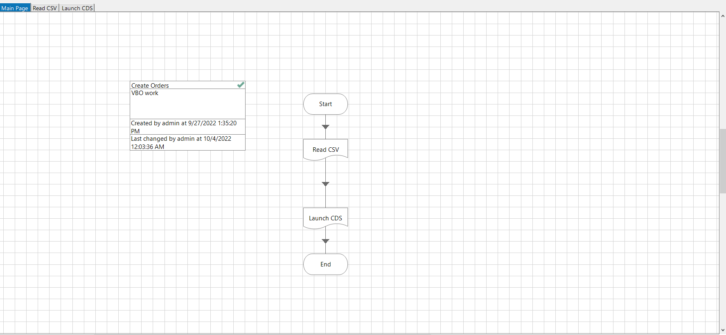
Overview of the Automation Process

Slide 4
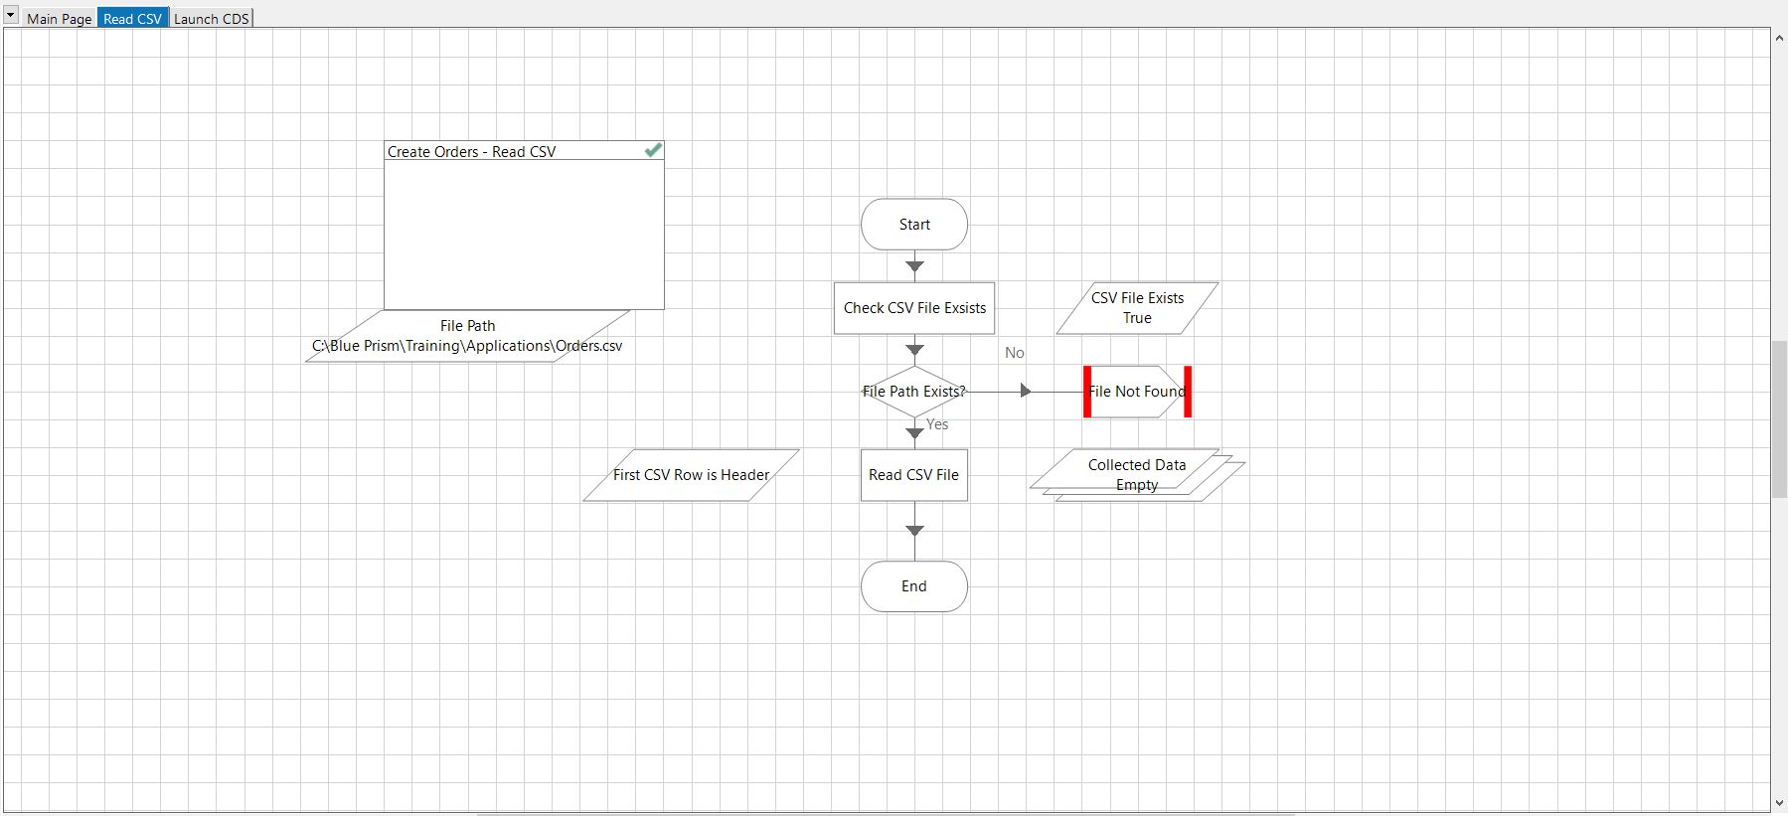
First step is to read the CSV file and input it into a data collection node

Slide 5
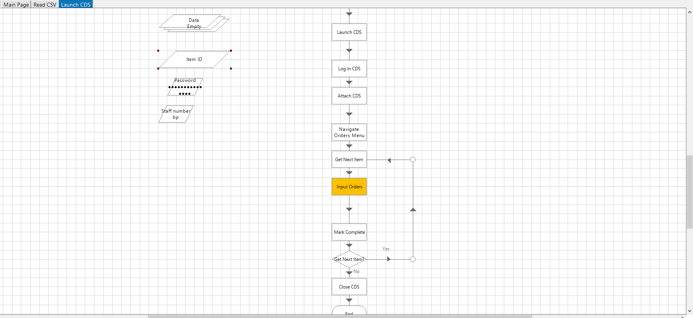
Finally, this process will launch Centrix Data Solutions, Login, and navigate the software, input the orders, and repeat until every order has been completed

Slide 6
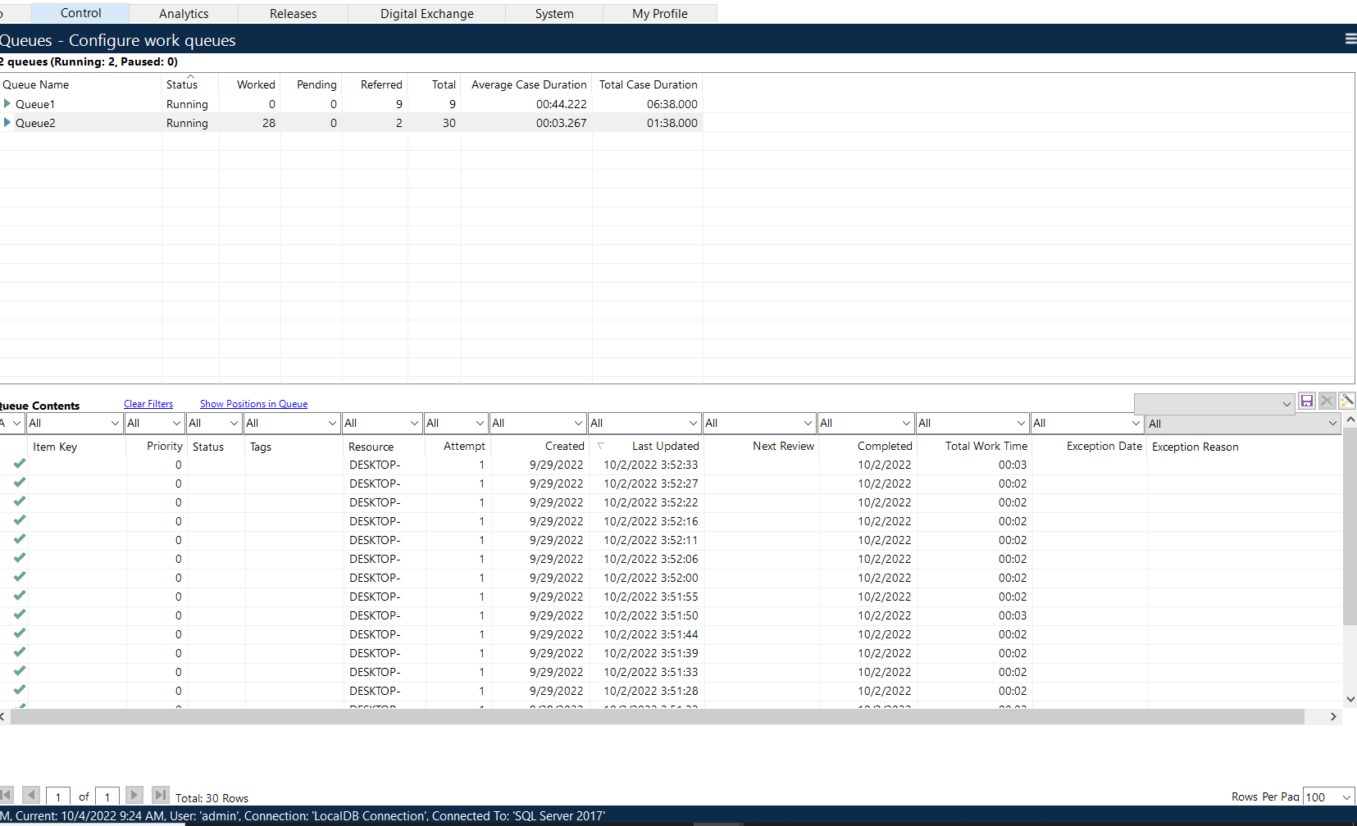
This is the control room where the data can be queued to run at any point

